Slide 1

Operating Systems and Linux Programming - M23DE0105
MCA Sem I - Academic Year : 2024 - 2025 ODD Semester
Shreetha Bhat
Assistant Professor.
School of CSA, REVA University.

Slide 2
Lecture - 1

Slide 3
AGENDA
Introduction
Quick look at Syllabus – Unit 4
Branching Control Structures

Slide 4

Quick Look at the Syllabus
Unit 4: Basic Linux Administration
Conditional Control Structures-if statement, case statement, Looping Control Structure-while, until, for, statements.
Filters, Stream editor SED and AWK, Linux System Communication: Introduction, write, read, wall commands, sending and handling mails. System Administration: Roles of a System Administrator.
04

Slide 5
Branching Control Structures
Program structures that are used to shift the point of execution are called Branching control structures.
05

Slide 6
Branching Control Structures
The if Conditional
This is the simplest of all the branching control structures.
if test_expression
then
true-block
fi
echo "Enter a number:"
read n
if [ “$n” -gt 10 ]
then
echo “ $n is greater than 10."
fi
06

Slide 7
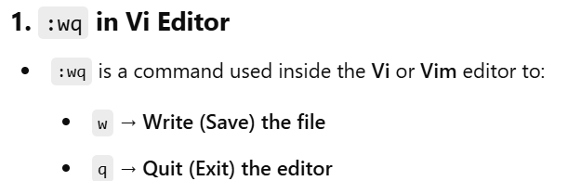
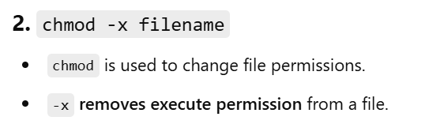
Branching Control Structures
Execute a Program in JSLinux
https://bellard.org/jslinux/vm.html?url=alpine-x86.cfg&mem=192
vi programname.sh
type program
Press esc
:wq enter
chmod -x filename.sh
sh filename.sh
07

Slide 8
Branching Control Structures
Execute a Program in JSLinux
To edit :
vi filename.sh
press i at the cursor position
edit
08

Slide 9
Branching Control Structures
The if Conditional
When the shell comes across an if construct, it evaluates the test expression that appears along with the keyword if first.
If this evaluation results in a true exit status, then the commands in the true-block are executed.
Otherwise, the true-block between then and fi is skipped and the control goes beyond the keyword fi.
09

Slide 10
Branching Control Structures
The if Conditional
An if construct may also have an else block.
if test_expression
then
true-block
else
false-block
fi
echo "Enter a number:"
read number
if [ “$n” -gt 10 ]
then
echo “ $n is greater than 10."
else
echo “ $n is not greater than 10."
fi
010

Slide 11
Branching Control Structures
The if Conditional
An if has another form also called multi-way branching
if test_expression
then
command(s)
elif test_expression
then
command(s)
else
command(s)
fi
echo "Enter a number:"
read number
if [ $number -gt 10 ]
then
echo "The number is greater than 10."
elif [ $number -eq 10 ]
then
echo "The number is equal to 10."
else
echo "The number is less than 10."
fi
011

Slide 12
Branching Control Structures
The test Command
This is a built-in shell command that evaluates the expression given to it as an argument and returns true if the evaluation of the expression returns a 0(zero) or false if the evaluation returns non-zero.
This command can be used directly using the keyword test or indirectly using square brackets.
$if test “$answer” = “Y”
$if [“$answer” = “Y”]
12

Slide 13
Branching Control Structures
The test Command
Test command has the following types:
Numeric tests
String Tests
File Tests
13

Slide 14
Branching Control Structures
The test Command
Numeric tests
In numeric tests, two numbers are compared using relational operators.
Sl. No | Operator | Meaning
1 | -eq | Equal to
2 | -ne | Not equal to
3 | -gt | Greater than
4 | -ge | Greater than or equal to
5 | -lt | Less than
6 | -le | Less than or equal to
14

Slide 15
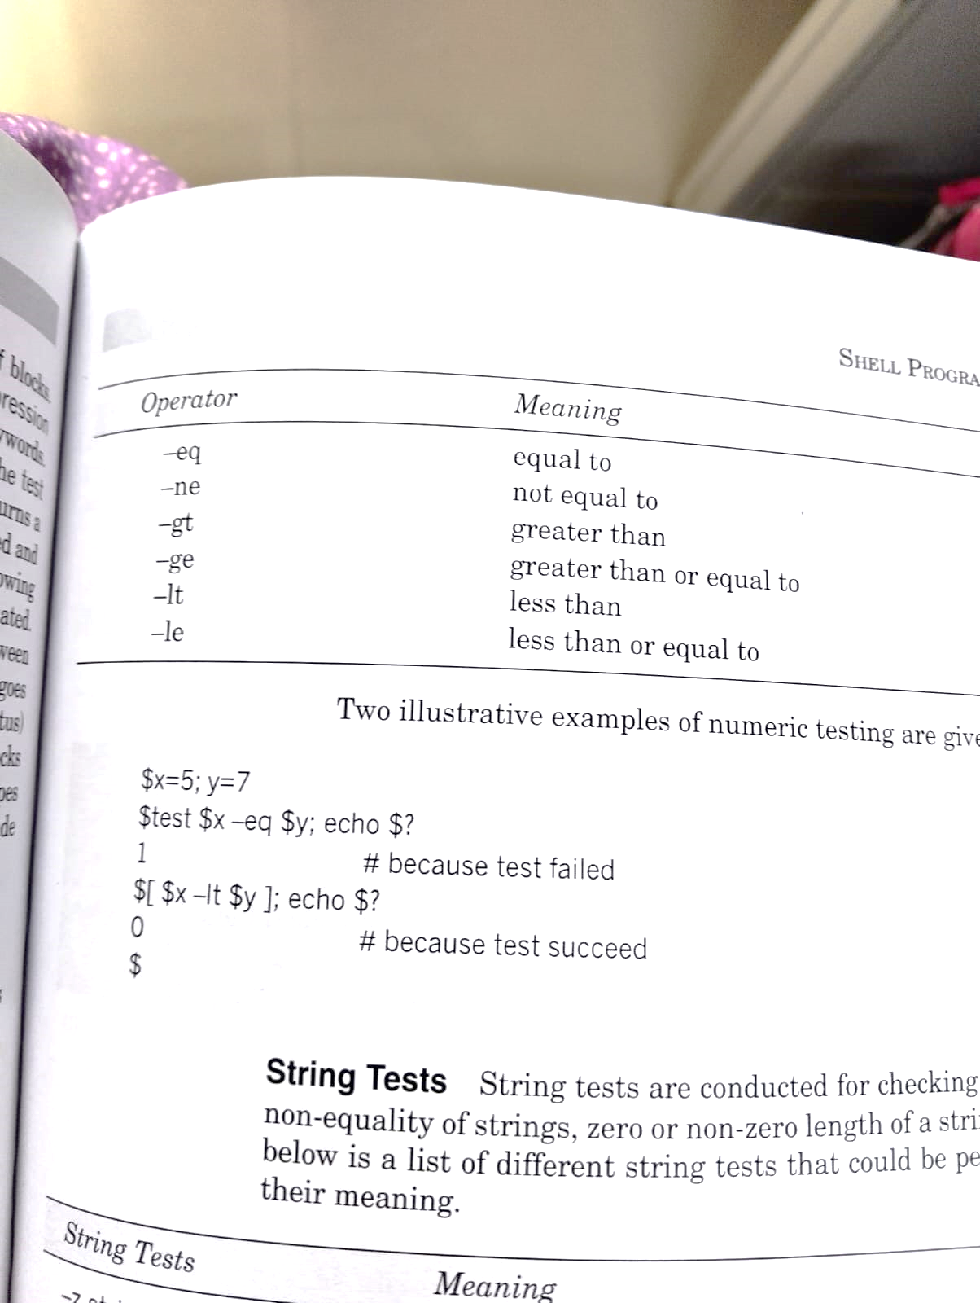
Branching Control Structures
The test Command
Numeric tests
15

Slide 16
Branching Control Structures
The test Command
Numeric tests
# Example program demonstrating numeric tests in Bash
# Define two variables
num1=10
num2=20
# Check if num1 is less than num2
if [ $num1 -lt $num2 ]; then
echo "$num1 is less than $num2"
fi
# Check if num1 is greater than num2
if [ $num1 -gt $num2 ]; then
echo "$num1 is greater than $num2"
fi
16

Slide 17
Branching Control Structures
The test Command
2. String tests
String Tests are conducted for checking equality of strings, non-equality of strings, zero or non-zero length of a string and so on.
17

Slide 18
Branching Control Structures
The test Command
2. String tests
Sl. No | String Tests | Meaning
1 | -z string | True if length of the string is zero, that is, the string is null.
2 | -n string | True if length of the string is non zero, that is, if string exists.
3 | string1 = string2 | True if string1 and string2 are identical.
4 | string1 != string2 | True if string1 and string2 are not identical.
5 | string1 | True if string1 is not the null string.
18

Slide 19
Branching Control Structures
The test Command
2. String tests
# Simple program demonstrating string tests
# Define two string variables
str1="hello"
str2="world"
# Check if the strings are equal
if [ "$str1" = "$str2" ]; then
echo "The strings are equal."
else
echo "The strings are not equal."
fi
# Check if str1 is not empty
if [ -n "$str1" ]; then
echo "str1 is not empty."
fi
# Check if str2 is empty
if [ -z "$str2" ]; then
echo "str2 is empty."
else
echo "str2 is not empty."
fi
19

Slide 20
Branching Control Structures
The test Command
3. File Tests
File Tests are conducted to check the status of the files and directories.
Using these tests one can find out the type of a file and permissions granted or not granted to it.
20

Slide 21
Branching Control Structures
The test Command
3. File Tests
Sl. No | Test | -d fileExit Status
1 | -e file | True if file exists.
2 | -f file | True if file exists and is a regular file.
3 | -r file | True if file exists and is readable.
4 | -w file | True if file exists and is writable.
5 | -x file | True if file exists and is executable.
 | -d file | True if file exists and is a directory
6 | -c file | True if file exists and is a character special file.
7 | -b file | True if file exists and is a block special file.
8 | -h file | True if file exists and is a link file.
21

Slide 22
Branching Control Structures
The test Command
3. File Tests
# Example program demonstrating file tests
# Define a file path
file="example.txt"
dir="example_dir"
# Check if the file exists
if [ -e "$file" ]; then
echo "$file exists."
else
echo "$file does not exist."
fi
22

Slide 23
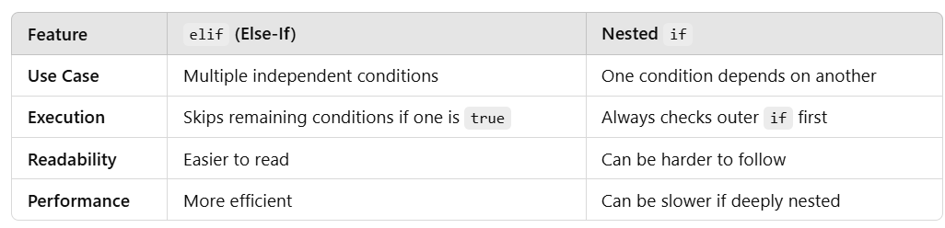
Branching Control Structures
23

Slide 24
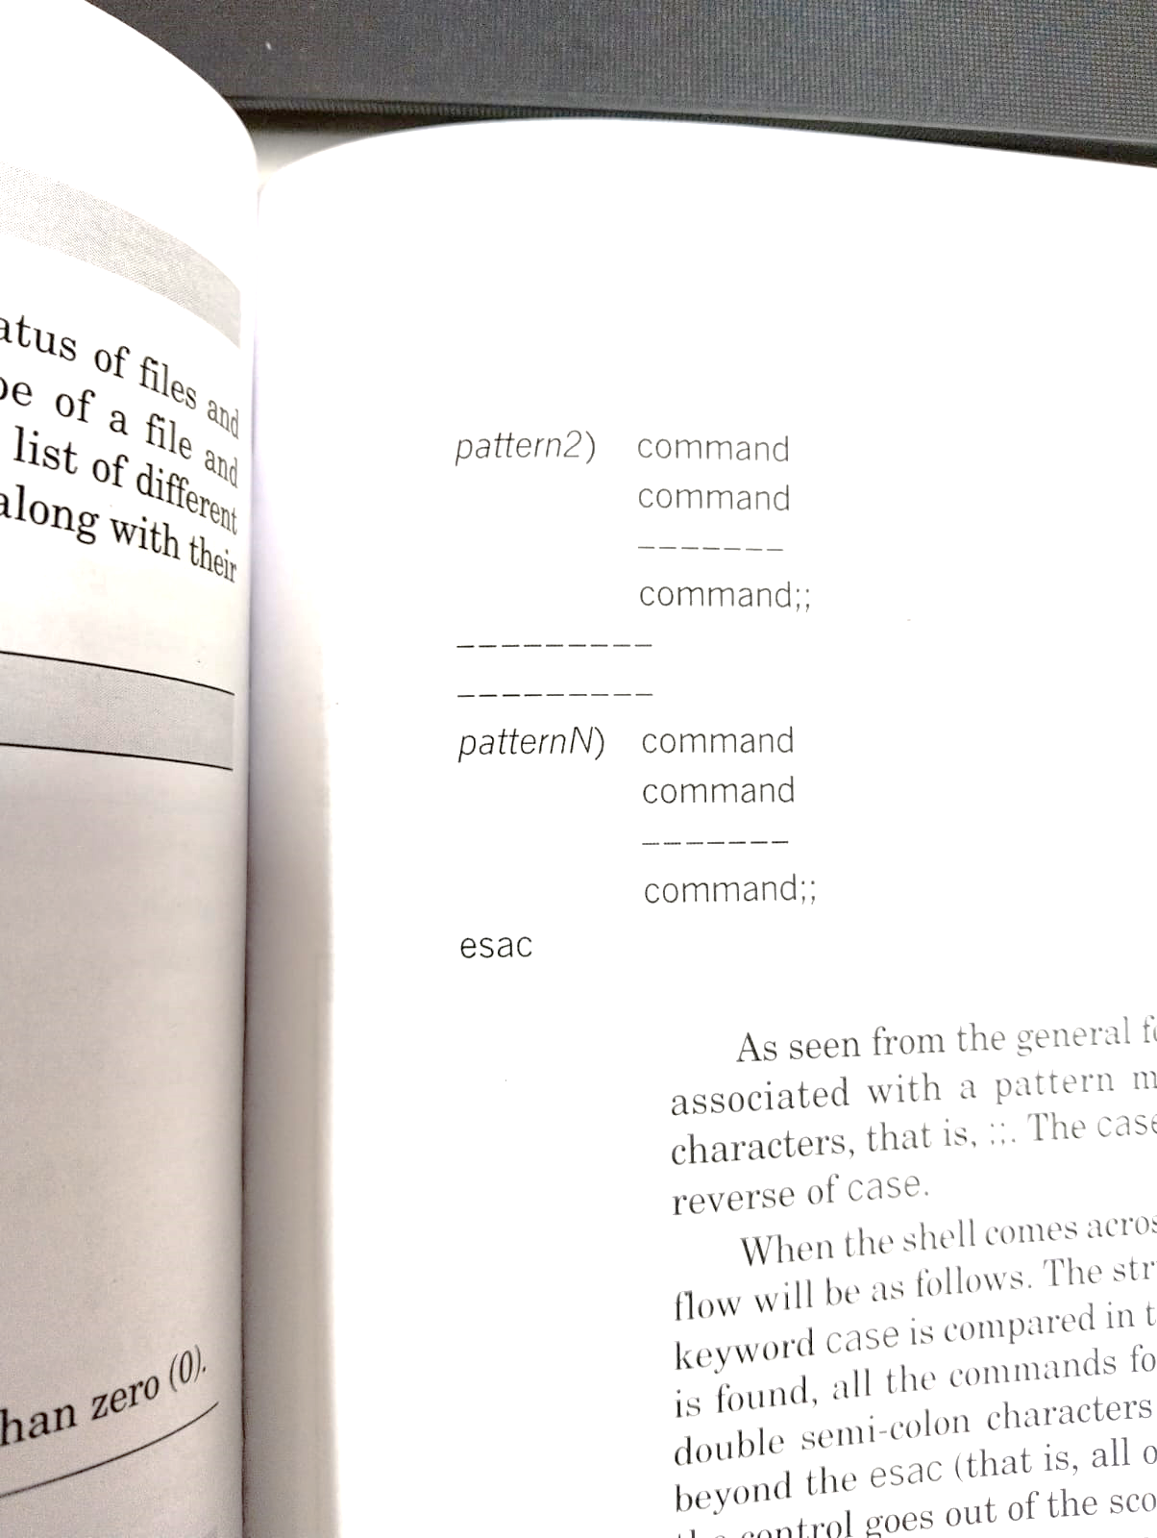
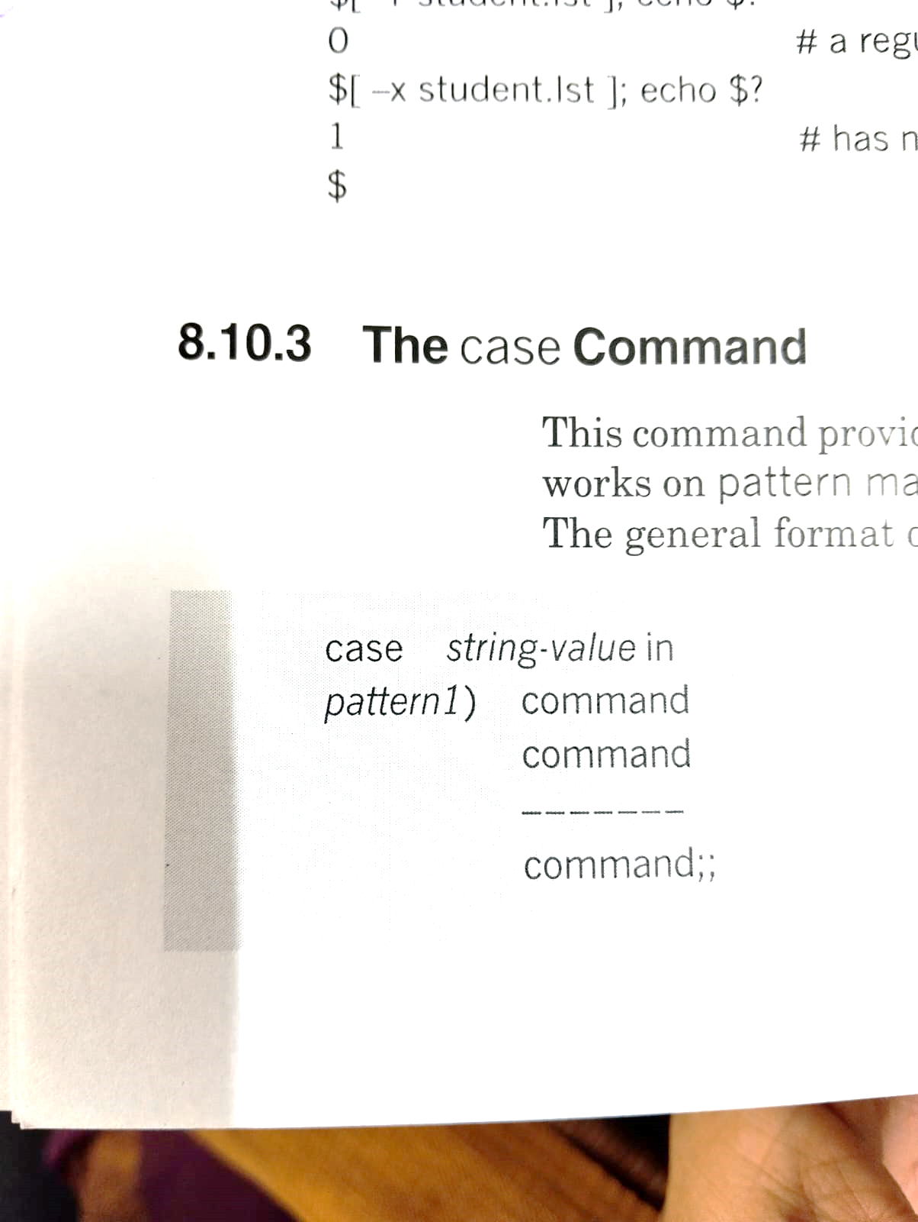
Branching Control Structures
The case Command
This command provides a multi-way decision-making facility.
It works on the concept of pattern matching and works only with string tests.
24

Slide 25
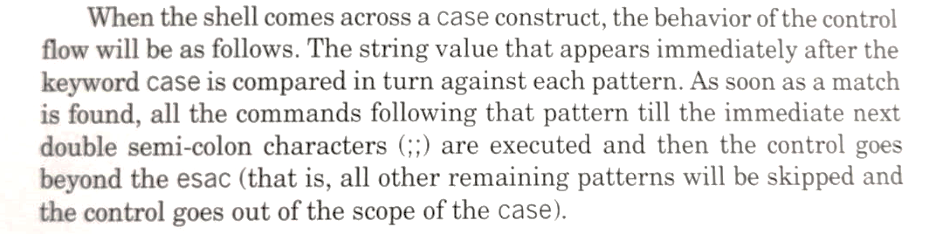
Branching Control Structures
The case Command
25

Slide 26
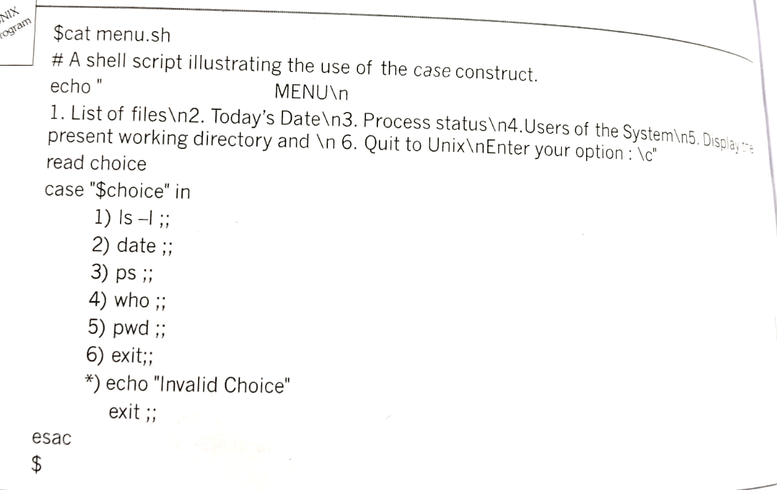
Branching Control Structures
The case Command
26

Slide 27
Loop Control Structures
In practical situations, executing a set of statements will be required repeatedly.
Shell has built-in constructs using which one can repeatedly execute a required set of statements.
27

Slide 28
Loop Control Structures
The While Command
This is one of the very widely used loop-control structures.
The general format is
while condition is true
do
set of commands that are executed repeatedly
done
28

Slide 29
Loop Control Structures
The While Command
# Example program demonstrating the usage of a while
# Initialize a counter variable
counter=1
# While loop to print numbers from 1 to 5
while [ $counter -le 5 ]; do
echo "Counter: $counter"
((counter++)) # Increment the counter by 1
done
echo "Finished counting."
29

Slide 30
Loop Control Structures
The until Command
The until command repeatedly executes the commands that appear between the do and done keywords as long as the condition remains false.
The general format is
until condition is false
do
set of commands that are executed repeatedly
done
30

Slide 31
Loop Control Structures
The until Command
# Example program demonstrating the usage of an until loop
# Initialize a counter variable
counter=1
# Until loop to print numbers from 1 to 5
until [ $counter -gt 5 ]; do
echo "Counter: $counter"
((counter++)) # Increment the counter by 1
done
echo "Finished counting."
31

Slide 32
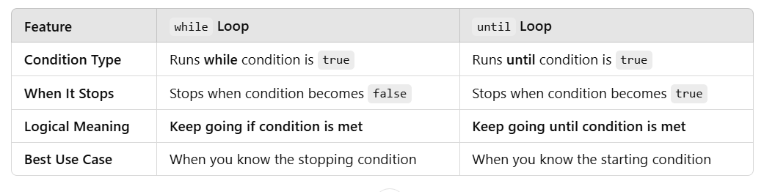
Loop Control Structures
32

Slide 33
Loop Control Structures
The for Command
This command works with a set of values generally given as a list.
The general format is
for variable in list
do
set of commands that are executed repeatedly
done
33

Slide 34
Loop Control Structures
The for Command
# Example program demonstrating the usage of a for loop
# Define a list of items
items=("apple" "banana" "cherry" "date" "elderberry")
# For loop to iterate over the list of items
for item in "${items[@]}"; do
echo "Item: $item"
done
echo "Finished listing items."
34

Slide 35
The Continue and Break statements
All the statements within a loop are executed as long as certain conditions are satisfied.
However, one can come out of the loop prematurely by using a break statement.
Similarly, a continue statement is used to resume the next iteration of the loop without considering the statements that appear after the continue statement within the loop.
35

Slide 36
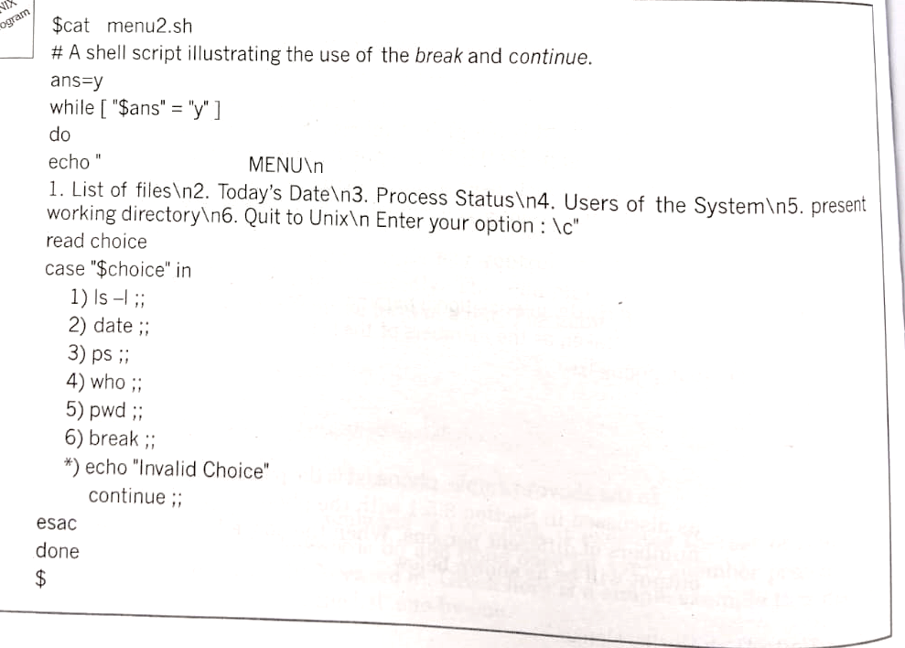
The Continue and Break statements
36

Slide 37
The Continue and Break statements
37

Slide 38
The expr command
This command is used to carry out basic arithmetic operations including modulo division on integers.
This command is used only when arithmetic operations are simple and few.
It is slow in processing.
For serious computations bc command can be used.
38

Slide 39
The expr command
The operators used for performing arithmetic operations are
+ (Plus) for addition, - (minus) for subtraction, *(star) for multiplication, /(slash) for division and % (percentage) for modulo division.
+ | Addition
- | Subtraction
* | Multiplication
/ | Division
% | Modulus
39

Slide 40
The expr command
While using this command
On either side of the arithmetic operators a blank or a tab must be present
The operator * must be despecalized or escaped, otherwise shell treats it as a wildcard.
40

Slide 41
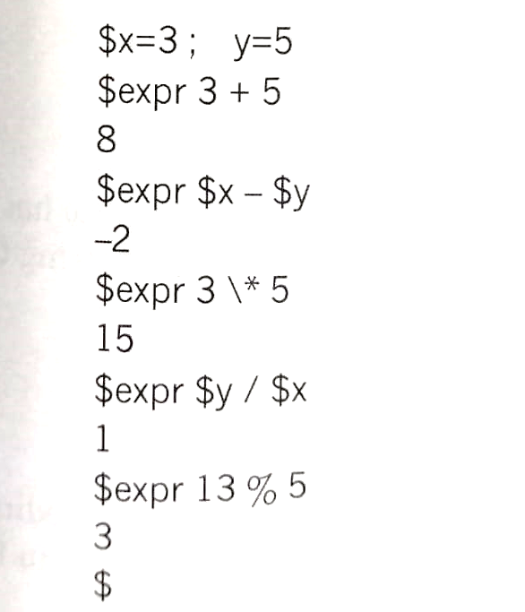
The expr command
41

Slide 42
The gedit command
gedit is a GUI-based text editor for Linux, mainly used in GNOME-based systems.
It provides a simple, easy-to-use interface for editing text files, scripts, and code.
Open a File in gedit
gedit filename
gedit myfile.txt
If myfile.txt exists, gedit opens it.
If not, gedit creates a new file named myfile.txt.
42

Slide 43
Filters
Filters are special types of commands that take input from standard input (stdin), process it, and provide output to standard output (stdout).
Commonly used in text processing
cat, grep, tee, sort, more, head, tail, cut paste, etc.
43

Slide 44
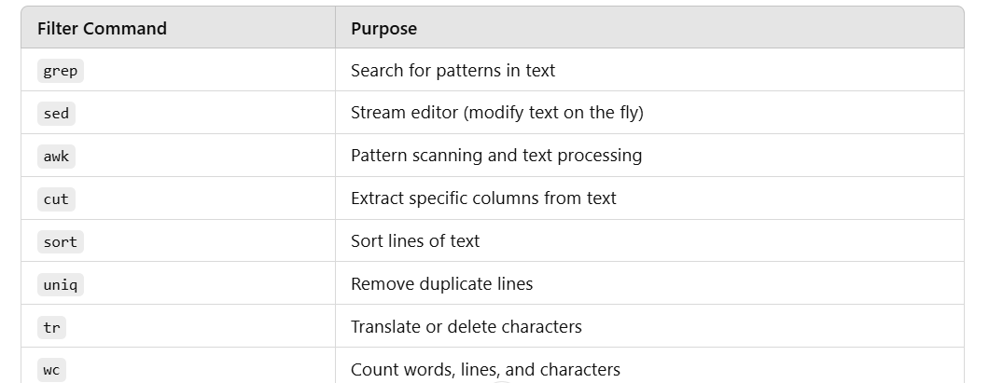
Filters
44

Slide 45
Stream Editor SED
‘sed’ (stream editor) is a powerful command-line tool in Unix/Linux used for parsing and transforming text.
It operates on input streams, such as files or standard input, and applies specified editing commands to modify the data.
sed is particularly useful for tasks like text substitution, deletion, insertion, and searching within files.
45

Slide 46
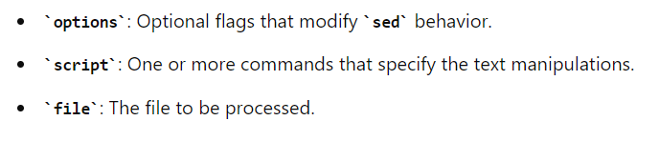
Stream Editor SED
Basic Syntax
The basic syntax for sed is:
sed [options] 'script' file
46

Slide 47
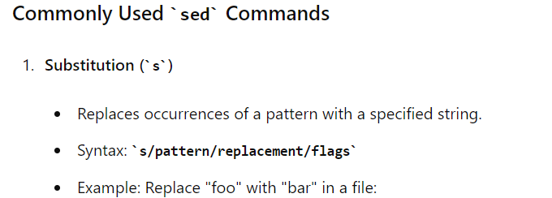
Stream Editor SED
sed 's/foo/bar/' file.txt
sed 's/foo/bar/g' file.txt
47

Slide 48
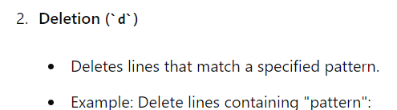
Stream Editor SED
sed '/pattern/d' file.txt
48

Slide 49
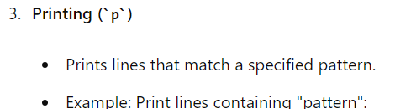
Stream Editor SED
sed -n '/pattern/p' file.txt
49

Slide 50
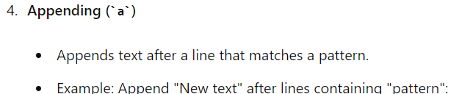
Stream Editor SED
sed '/pattern/a\New text' file.txt
50

Slide 51
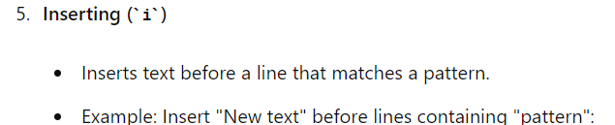
Stream Editor SED
sed '/pattern/i\New text' file.txt
51

Slide 52
Awk
Awk is a filter program developed in 1977 by Aho, Weinberger, and Kernighan.
It is a programming language with C-like control structures, functions and variables.
One of the essential features of this filter is that it operates at the field level.
In Linux, awk is available as gawk (GNU awk).
GNU Awk, commonly called gawk, is the GNU Project's implementation of the AWK programming language.
52

Slide 53
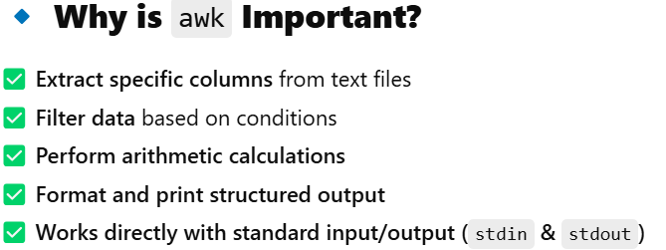
Awk
53

Slide 54
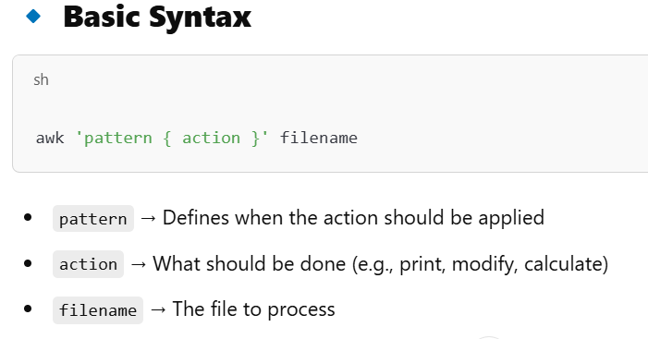
Awk
54

Slide 55
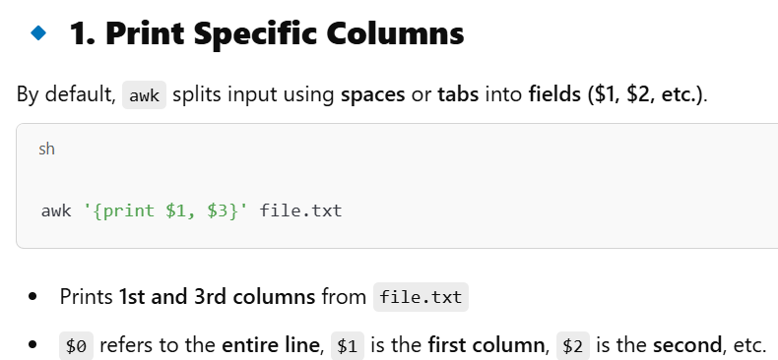
Awk
55

Slide 56
Awk
Example
File.txt
Alice 25 Developer
Bob 30 Manager
Charlie 28 Analyst
command
awk '{print $1, $3}' file.txt
Output
Alice Developer
Bob Manager
Charlie Analyst
56

Slide 57
Awk
Syntax
The general format of an awk command line is
$awk options ‘program’ filelist
Where the
Use of options is optional
filelist will have zero or more input filenames and
Program will have one or more statements having the following general format
pattern {action}
57

Slide 58
Awk
Syntax
The pattern component indicates the basis for a line or record selection and manipulation.
A pair of curly braces surround the action part of every program statement.
The action part is made up of C like statements, which perform actions on lines or records selected based upon the pattern component.
Awk employs only 2 options:
-F, species the input field separator.
-f specifies that the program is on a separate file.
58

Slide 59
Awk
Structure of an awk Script
An awk script is made up of 3 sections
BEGIN { ……….}
Program Statement (s)
END {………}
Body
The presence of any of these sections is not mandatory.
An awk program must contain at least one of these sections.
59

Slide 60
Awk
Structure of an awk Script
The BEGIN Section
This section is recognized by the keyword or the pattern BEGIN.
All the instructions present in this section are executed once before the awk actually starts reading and executing program statements from the body.
Instructions in this section are used for performing tasks like initializing variables, generating headings, and other similar tasks, which must be completed before the body processing starts.
60

Slide 61
Awk
Structure of an awk Script
The BEGIN Section
A typical BEGIN section statement that identifies the input field separator as the colon (:) character is shown below.
BEGIN {FS “:”}
FS in the above statements means the input Field Separator.
61

Slide 62
Awk
Structure of an awk Script
The END Section
The end section is recognized by the keyword or the pattern END.
All the instructions present in this section are executed once after the last line of the input has been processed.
Instructions in this section are used for generating summary reports.
62

Slide 63
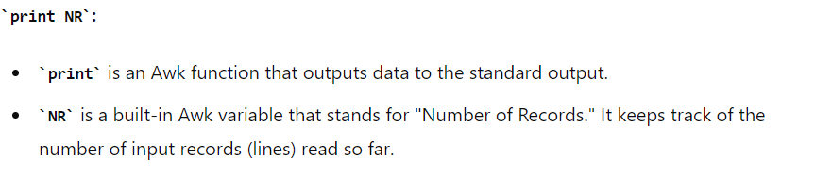
Awk
Structure of an awk Script
The END Section
A typical END section statement that prints number of records processed looks as follows:
‘END {print NR}’
63

Slide 64
Awk
Structure of an awk Script
The BODY Section
This section contains one or more actual program statements.
64

Slide 65
Awk
Variables
Awk has two types of variables:
User Defined Variables
Built in Variables
65

Slide 66
Awk
Variables
User-Defined Variables
These are names of storage locations that hold either strings or numbers.
These names are constructed using only alphanumeric and underscores and begin with a letter.
The variables once defined are either set to zero or null string automatically.
66

Slide 67
Awk
Variables
Built-in Variables
Built-in variables are predefined.
FS, RS, NF, NR, and OFS are some examples of built-in variables.
Names of these variables are constructed using uppercase letters.
FS, RS, and others have default values, and some like NF, NR, and others are controlled by awk.
67

Slide 68
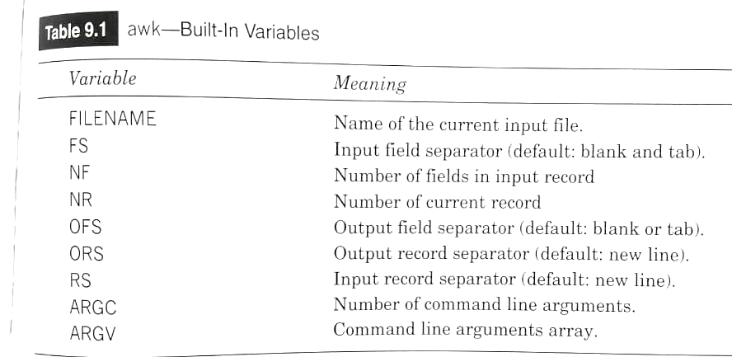
Awk
Variables
Built-in Variables
68

Slide 69
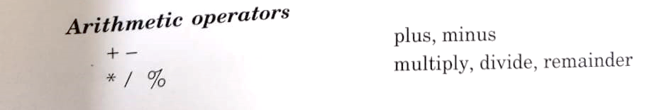
Awk
Operators
Awk has Arithmetic, relational, logical, and Assignment operators.
69

Slide 70
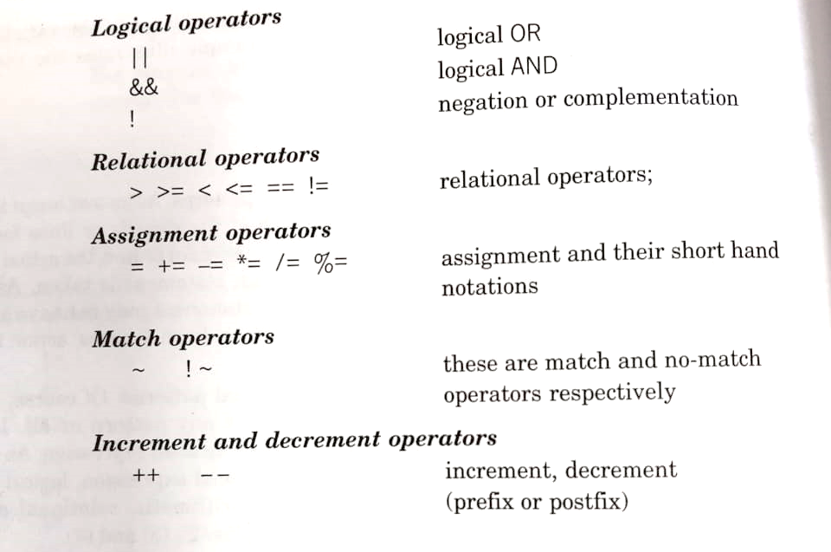
Awk
Operators
Awk has Arithmetic, relational, logical, and Assignment operators.
70

Slide 71
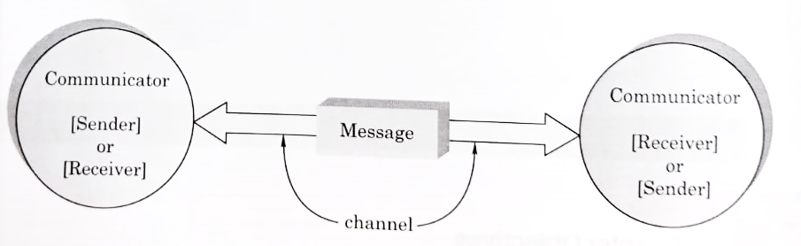
Linux Communication Tools
The Communication Process
A group of researchers working on the development of Unix identified the need for communication and developed programs to facilitate communication.
71

Slide 72
Linux Communication Tools
The Communication Process
The elements involved in a communication process are
the sender (the person who transmits the message),
the receiver( the person who receives the message),
the message (the actual information to be communicated)
The channel (the medium or the connectivity through which the information flows).
72

Slide 73
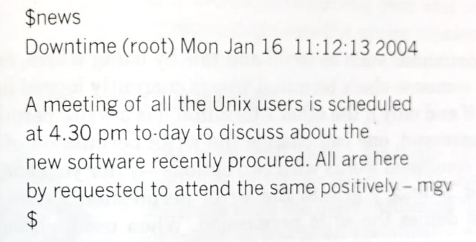
Linux Communication Tools
The news command
This command is used by a user to read messages sent by the system administrator.
The news will be saved as a file in the /usr/news directory and is accessible by all.
73

Slide 74
Linux Communication Tools
The news command
Assuming that there was only one news item, if the news command is given once again, the system prompt $ will be returned.
In case more than one news item is present, the news command will display all the unread news items one by one continuously with the most recent one appearing first.
74

Slide 75
Linux Communication Tools
The news command
Options:
-a -> displays all the read and unread news items.
-n -> displays list containing names of news items that are not yet read
-s -> Displays count of unread news items
75

Slide 76
Linux Communication Tools
The write command
This command allows the user to have two-way communication with another user who is currently logged in alternately, one after the other.
This command copies the message typed by the sender at his or her terminal to the screen of the receiver line by line.
If mgv is the login name of the sender and hmk is the login name of the receiver then the following command
The conversation continues until one or both the users decide to terminate it.
76

Slide 77
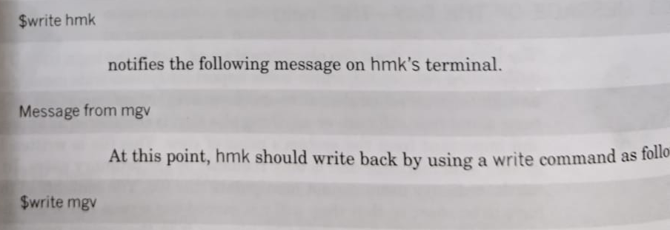
Linux Communication Tools
The write command
77

Slide 78
Linux Communication Tools
The wall command
The term wall stands for write all.
Using this command one can send a message to all the users on the system.
This is known as broadcasting and is specifically designed for system administrators.
When used by the super user, this command over rides all write permission constraints and writes the message on all the terminals that are being currently used.
78

Slide 79
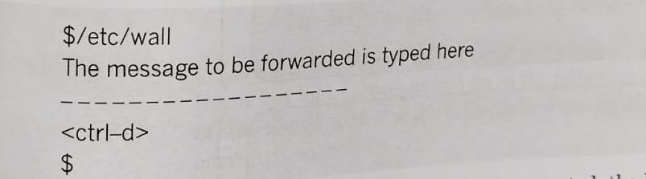
Linux Communication Tools
The wall command
79

Slide 80
Linux Communication Tools
Electronic Mail
Sending and receiving messages using computer and communication tools such as mail, mailx, elm, and others is known as electronic mail or simple email.
Over the years, plenty of tools for sending, receiving as well as managing mail have been developed.
80

Slide 81
Linux Communication Tools
Electronic Mail The Mail Command
This is the most simplest and basic e-mail program that is available on all Linux systems.
This command contains a text editor with very limited features by using which, mail notes are composed.
This command can be used to both send as well as receive mails.
81

Slide 82
Linux Communication Tools
Electronic Mail The Mail Command
Sending a Mail.
The general syntax of the mail command as used for sending mail to one or more destinations is as follows
$mail options address(es)
82

Slide 83
Linux Communication Tools
Electronic Mail The Mail Command
Sending a Mail.
Example
$mail dvm, hsp, mcehas@etc.edu
Is a valid mail command line.
Here, dvm and hsp are the recipient’s login names of the local users who are connected directly to the system.
mcehas@etc.edu is the address of the person connected via the internet.
83

Slide 84
Linux Communication Tools
Electronic Mail The Mail Command
Sending a Mail.
Different addresses are separated by commas, blank spaces can also be used as address separators.
The text of the message has to be typed after the command line.
The most general way is by typing it at the terminal.
In case of typing errors, they must be corrected before a line is terminated.
84

Slide 85
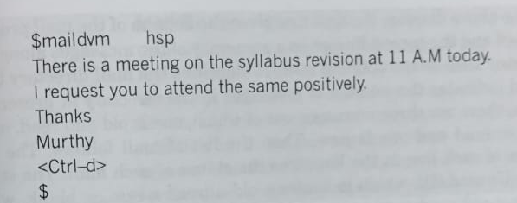
Linux Communication Tools
Electronic Mail The Mail Command
Sending a Mail.
The message typing is terminated by using either the <Ctrl-d> or by typing a single dot (.) on a separate line.
85

Slide 86
Linux Communication Tools
Electronic Mail The Mail Command
Sending a Mail.
Upon the recognition of either <ctrl-d> or a single dot the mail command forwards the text to dvm as well as hsp, the login names of the local users
86

Slide 87
Linux Communication Tools
Electronic Mail The Mail Command
Receiving a Mail.
The mail is received by using the mail command without any argument.
When the mail command is used without any argument, the user is said to be in the read mode.
When the mail command is used in the read mode, a list of all mails currently on the user’s system are listed.
87

Slide 88

Linux Communication Tools
Electronic Mail The Mail Command
Receiving a Mail.
88

Slide 89
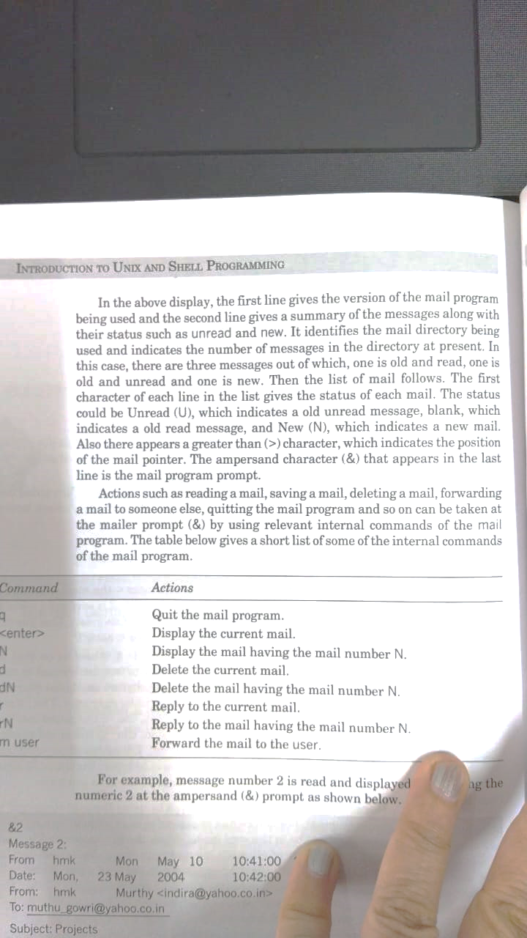
Linux Communication Tools
Electronic Mail The Mail Command
Receiving a Mail.
89

Slide 90
Linux Communication Tools
Electronic Mail The Mail Command
Receiving a Mail.
90

Slide 91
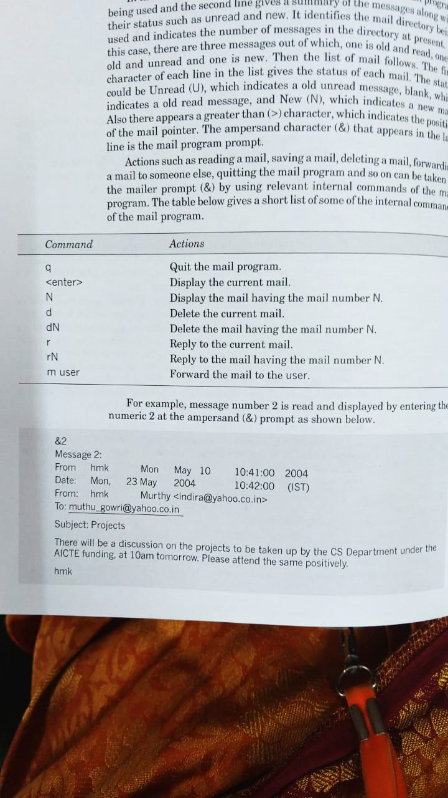
Linux Communication Tools
Electronic Mail The Mail Command
Receiving a Mail.
91

Slide 92
Linux Communication Tools
Electronic Mail The Mail Command
Receiving a Mail.
92

Slide 93
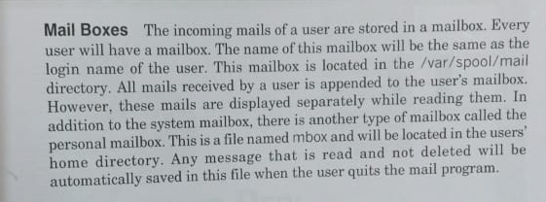
Linux Communication Tools
Mail Boxes
93

Slide 94
System Administrator
Role
The Linux system administrator manages and maintains Linux-based systems. Here are some key areas and tasks to focus on:
1. System Installation and Configuration
Installing Linux: Choose a distribution (e.g., Ubuntu, CentOS, Debian) and install it.
Initial Setup: Configure hostname, time zone, network settings, and users.
Package Management: Use package managers like apt, yum, or dnf to install and manage software.
94

Slide 95
System Administrator
Role
2. User and Permission Management
User Accounts: Create, modify, and delete user accounts using useradd, usermod, and userdel.
Permissions: Set file and directory permissions using chmod, chown, and chgrp.
Sudo Access: Configure sudo privileges in /etc/sudoers or using visudo.
95

Slide 96
System Administrator
Role
3. Networking
Network Configuration: Set up network interfaces using tools like ifconfig, ip, nmcli, or nmtui.
Firewall: Configure firewall rules with iptables or firewalld.
SSH: Securely configure SSH access for remote management.
96

Slide 97
System Administrator
Role
4. Security
Updates: Regularly update the system using package managers.
Firewall and SELinux/AppArmor: Implement and manage firewalls and security modules.
Monitoring and Logs: Use tools like auditd, fail2ban, and logwatch to monitor logs and security events.
97

Slide 98
System Administrator
Role
5. Storage and Filesystems
Disks and Partitions: Manage disks and partitions using fdisk, parted, or lsblk.
Filesystems: Create and manage filesystems with mkfs, mount, and umount.
LVM: Use Logical Volume Manager (LVM) for flexible disk management.
98

Slide 99
System Administrator
Role
6. Process and Resource Management
Processes: Monitor and manage processes using ps, top, htop, and kill.
Resource Usage: Check resource usage with free, vmstat, iostat, and df.
Systemd: Manage system services with systemctl.
99

Slide 100
System Administrator
Role
7. Backup and Recovery
Backup Tools: Use rsync, tar, and cron for backups.
Automated Backups: Schedule regular backups using cron jobs.
Disaster Recovery: Plan and test recovery procedures.
100

Slide 101
Shell Scripts Execution
JS Linux
https://bellard.org/jslinux/vm.html?url=alpine-x86.cfg&mem=192
Jdoodle
https://www.jdoodle.com/test-bash-shell-script-online/
Cocalc
https://cocalc.com/
4. OneCompiler
https://onecompiler.com/bash
101

Slide 102

Thank You

